Slide 1
Wine vs Whisky
Chenyze

Slide 2
Why these two subreddits?
Similar enough to be challenging
Both are alcohol
Some similar jargon
bottle
region
length
full-bodied
finish
Different enough for classification
grape vs malt
vintage vs years
winery vs distillery
tannins vs peat

Slide 3
Business Relevance
Email filtering for retailers without e-commerce sites
Reduce grunt work by sending queries/orders to relevant personnel
Search engine optimization for brands/retailers
Use the everyday words that potential customers use to discuss/search wines and whiskies

Slide 4
The Process

Slide 5
Iterative Approach
To get a working prototype quickly
Learn from the process how I wanted to refine my models

Slide 6
Preparing the data
Data extraction
via Reddit’s API
Data cleaning
500+ rows out of 900+ rows for each subreddit had no `selftext`
concatenate `title` and `selftext`

Slide 7
Preparing the data
Data pre-processing
Markup elements (e.g. /n), URLs
Regex to remove
Emoji
→Regex to remove
Accented characters (e.g. château)
→Decode to UTF-8

Slide 8
Modeling Iteration 1
Compare word vectorizers: CountVectorizer vs TF-IDF
English stop-words, no other hyper-parameters
Compare classifiers: Logistic Regression vs Multinomial Naïve Bayes
default hyper-parameters

Slide 9
Modeling Iteration 1
Compare word vectorizers: CountVectorizer vs TF-IDF
English stop-words, no other hyper-parameters
Compare classifiers: Logistic Regression vs Multinomial Naïve Bayes
default hyper-parameters
Notes:
The multinomial form of Naive Bayes was used because we are dealing with a multi-class, multi-experiment problem, and we are using word frequency (discrete) to determine our predictors.
TF-IDF looks at relative frequency and penalizes very common words

Slide 10
Modeling Iteration 1: results
 | CVEC |  |  | TFIDF
Model | X_train | X_val | overfit diff | X_train | X_val | overfit diff
LR_def | 0.994417 | 0.901674 | 0.0927437 | 0.988137 | 0.91841 | 0.0697267
MNB_def | 0.972784 | 0.905858 | 0.0669266 | 0.976274 | 0.903766 | 0.0725079

Slide 11
Modeling iteration 2: things to refine
EDA and Pre-processing
Use SpaCy to lemmatize and tokenize
Use GridSeach to tune CountVectorizer and TF-IDF on
`max_features`
`min_df` (but not `max_df`)
`ngram_range`
Word clouds to compare subreddits

Slide 12
Modeling iteration 2: things to refine
Modeling
GridSearch to tune hyper-parameters for classifiers
Compare classification models
Logistic Regression
Multinomial Naive Bayes
Random Forest Classifier

Slide 13
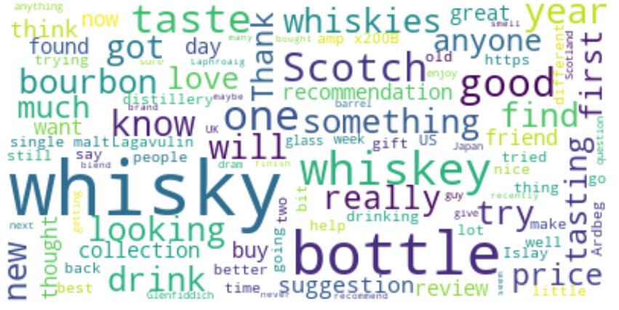
r/whisky – based on all words

Slide 14
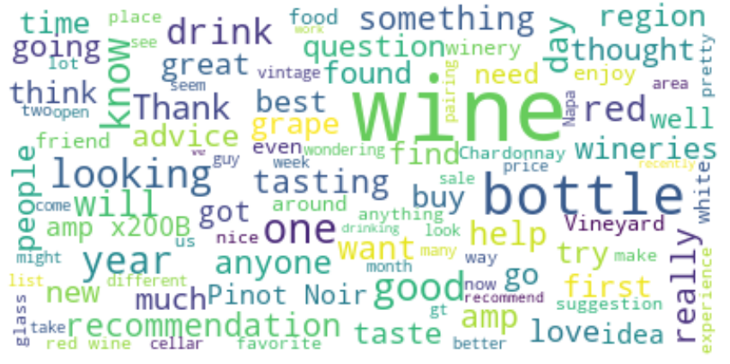
r/wine – based on all words

Slide 15
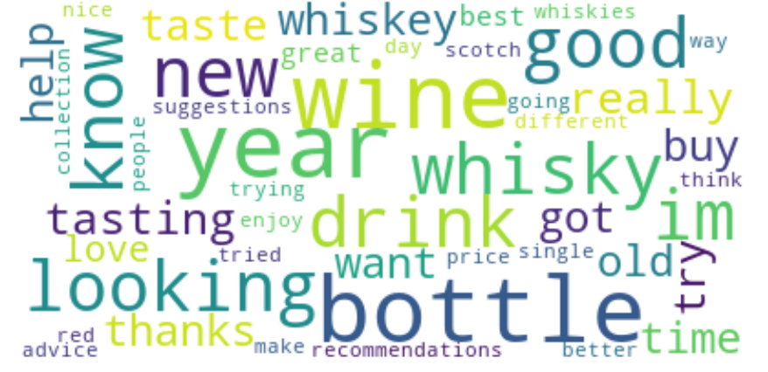
Combined word cloud

Slide 16
Modeling Iteration 2:Hyper-parameters
Count Vectorizer
TF-IDF
cvec__max_features: 1500
cvec__min_df: 2
cvec__ngram_range: (1, 1)
tfidf__max_features: 1500
tfidf__min_df: 3
tfidf__ngram_range: (1, 1)
Notes:
cvec_params = {
'cvec__max_features': [1000, 1500, 2000, 2500, 3000, 3500],
'cvec__min_df': [2, 3],
'cvec__ngram_range': [(1,1), (1,2), (1,3)]
}
tfidf_params = {
'tfidf__max_features': [1000, 1500, 2000, 2500, 3000, 3500],
'tfidf__min_df': [2, 3],
'tfidf__ngram_range': [(1,1), (1,2), (1,3)]
}

Slide 17
Modeling Iteration 2:Hyper-parameters
Logistic Regression
Multinomial Naïve Bayes
C: 0.1747528400007683
penalty: l2
solver: liblinear
alpha: 0.5
fit_prior: False
Notes:
lr_params = {
'penalty':['l1','l2'],
'solver':['liblinear'],
'C':np.logspace(-5,0,100)
}
mnb_params = {
'alpha': np.linspace(0.5, 1.5, 2),
'fit_prior': [True, False]
}

Slide 18
Modeling Iteration 2:Hyper-parameters
Random Forest Classifier
rf__n_estimators: [100, 150, 200]
rf__max_depth: [None, 1, 2, 3, 4, 5]
Notes:
'rf__n_estimators': [100, 150, 200],
'rf__max_depth': [None, 1, 2, 3, 4, 5],

Slide 19
Modeling Iteration 2: results
 | CVEC |  |  | TFIDF
Model | X_train | X_val | overfit diff | X_train | X_val | overfit diff
LR_def | 0.994417 | 0.901674 | 0.0927437 | 0.988137 | 0.91841 | 0.0697267
MNB_def | 0.972784 | 0.905858 | 0.0669266 | 0.976274 | 0.903766 | 0.0725079

Slide 20
Modeling Iteration 2: results
 | CVEC |  |  | TFIDF
Model | X_train | X_val | overfit diff | X_train | X_val | overfit diff
LR_def | 0.994417 | 0.901674 | 0.0927437 | 0.988137 | 0.91841 | 0.0697267
MNB_def | 0.972784 | 0.905858 | 0.0669266 | 0.976274 | 0.903766 | 0.0725079
MNB_tuned | 0.973482 | 0.920502 | 0.0529801 | 0.972784 | 0.895397 | 0.0773869
RF_tuned | 1 | 0.891213 | 0.108787 | 1 | 0.901674 | 0.0983264
Notes:
With CVEC, hyper-tuned LR and MNB tend to overfit to a smaller extent than their respective models with default hyper-parameters.
We might also be able to infer that reducing our features (by setting max_depth) for CVEC has also helped to reduce overfitting.
However with TF-IDF, hyper-tuned models don't necessarily do better than models with default hyper-parameters.
Random Forest was supposedly the solution to reduce the overfitting tendency of Decision Trees, but how much our RF_tuned model overfit, it seems to not perform as well as other models.
With CVEC, our hyper-tuned MNB was the best model giving us the highest X_val score, as well as the smallest overfit value.
With TF-IDF, the results are again quite mixed. For instance, LR_1 (untuned) gave us the highest X_val score but it was LR_tuned that gave us the smallest overfit value.
Overall, MNB_tuned provided the best results: the CVEC_X_val score was the highest of all X_val scores, and the corresponding CVEC_overfit_diff score was also the smallest in the table.

Slide 21
Evaluating with test data: Final model
Count Vectorizer
Multinomial Naïve Bayes
cvec__max_features: 1500
cvec__min_df: 2
cvec__ngram_range: (1, 1)
alpha: 0.5
fit_prior: False

Slide 22
Evaluating with test data: Getting test data
Extracted 100 rows from each subreddit
Compared for duplicates with train dataset
! almost all ‘new’ r/whisky rows were duplicates
left with 101 rows from r/wine, 13 rows from r/whisky
Regex + Spacy (lemmatize)

Slide 23
Evaluating with test data: The results
Overall train score : 0.9706959706959707
Overall test score is: 0.8859649122807017
Overfit by 0.084
Not awesome, but not too bad

Slide 24
Moving forward
Re-do pre-processing without removing hyperlinks
Add 'wine' and 'whisky' into the list of stop words
Create my own list of stop words e.g. bottle, taste
Hyper-tune Random Forest Classifier without 'None'

